Slide 1
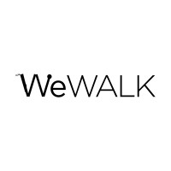
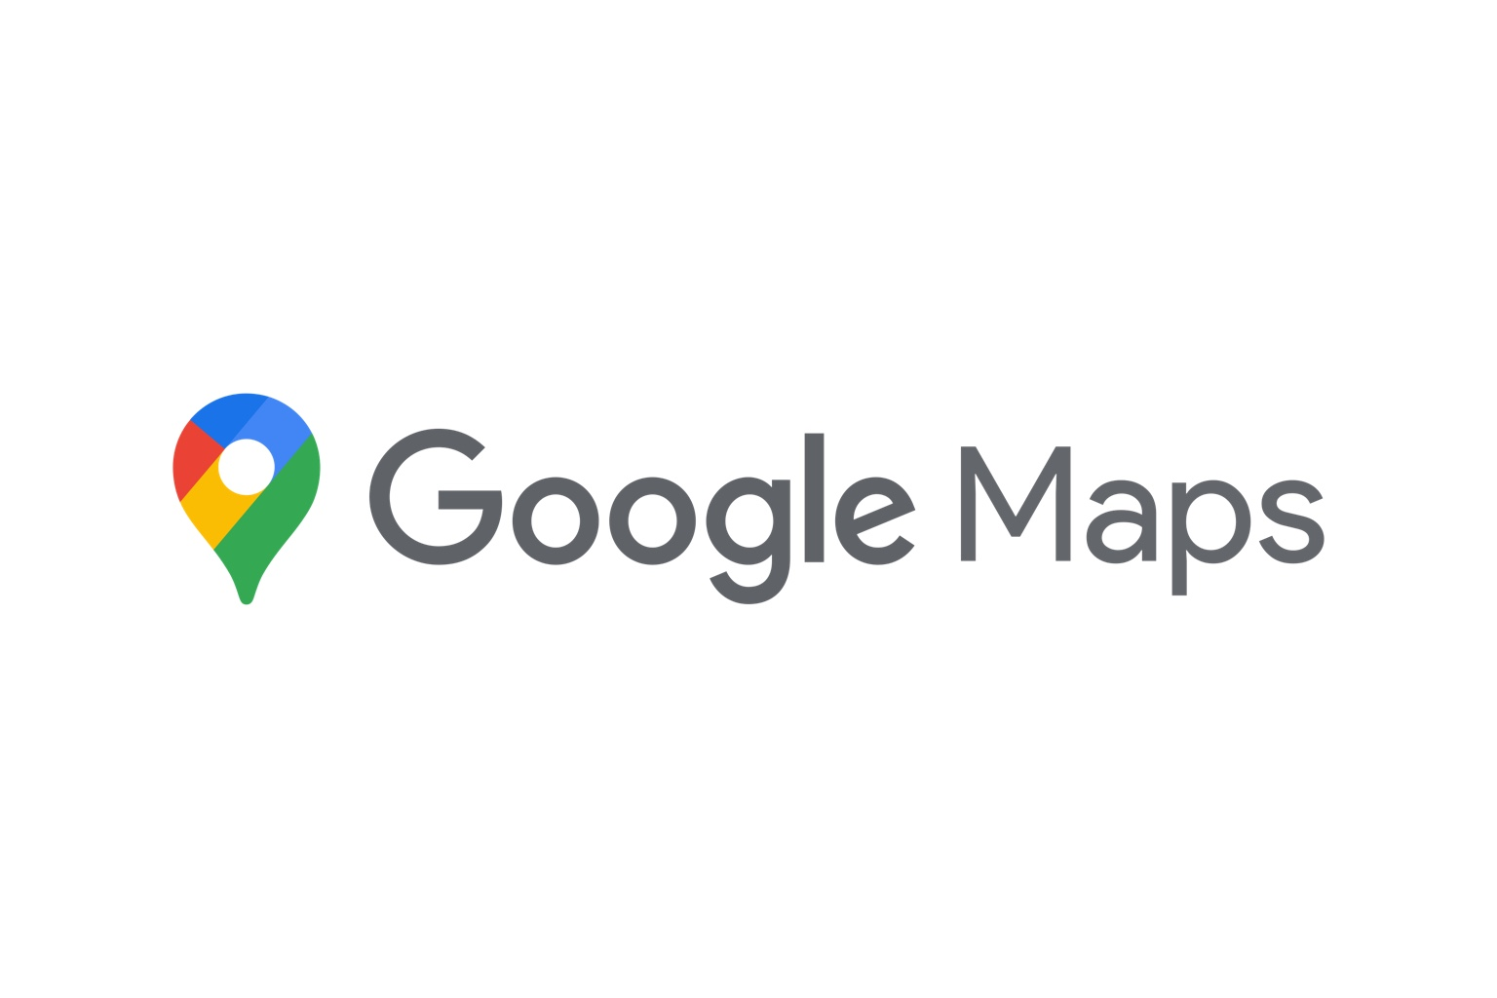
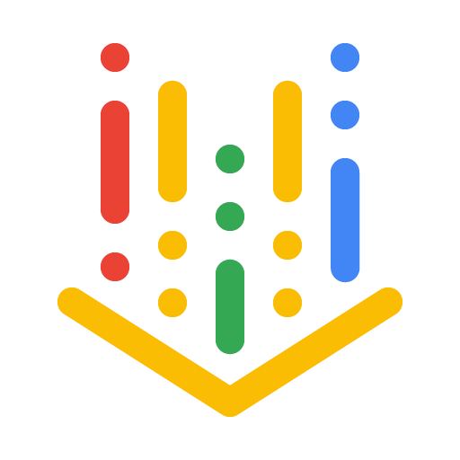



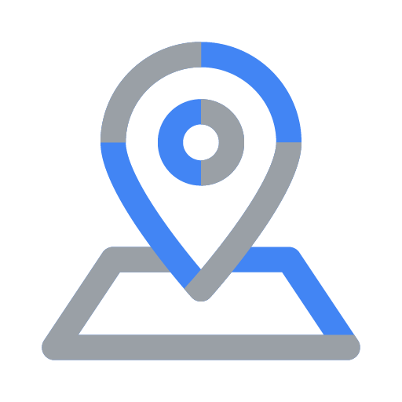
WeWALK × Google Cloud — Product & AI Integration Overview
• Step-by-step multimodal navigation optimized for visually impaired users.
• Smart Cane Voice Assistant (Current & Beta) powered by Vertex AI Agent Engine, Gemini 2.5 Flash/Pro, Google ADK.
• Future offline Voice Assistant model embedded into WeWALK iOS & Android apps.
• Situational Awareness CV: object finding, entrance detection, room understanding, clothing recognition.
• Mobility Analytics: cane angle, swipes, obstacle interactions, AIM training data.
• Backend: Cloud Run, Cloud SQL, Firestore, Cloud Logging, Monitoring, Artifact Registry.
• Recently migrated from AWS to Google Cloud using credit support.

Slide 2
High-Level Architecture (Smart Cane + Phone + Google Cloud)
Smart Cane & Mobile App
• Smart Cane Voice Assistant
• On-device Navigation
• Phone Camera for CV
Google Cloud & AI Services
• Vertex AI (Gemini 2.5 Flash/Pro)
• Agent Engine + Google ADK
• Maps & Geospatial APIs
• Cloud Run / Cloud SQL / Firestore
• Logging + Monitoring
↔

